Slide 1
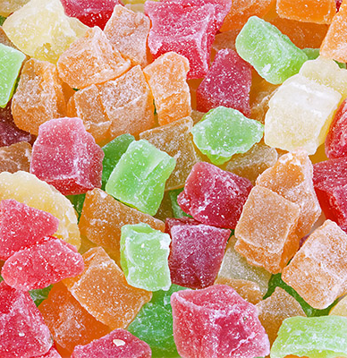

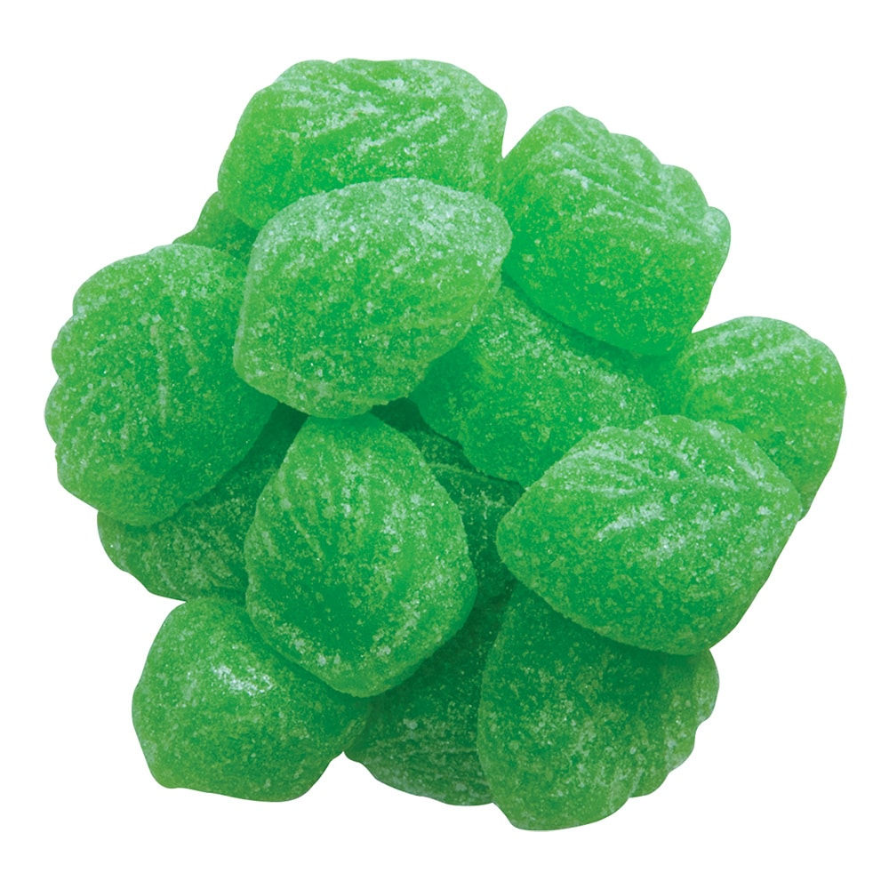
Production of marmalade products
$ 322 thousands
$ 174 thousands
624 tons
Will be updated
IRR: 27,8%
NPV: $ 490,1 thousands
Export: 30%
Local market: 70%
48 month
Not available
Will be updated

