Slide 1
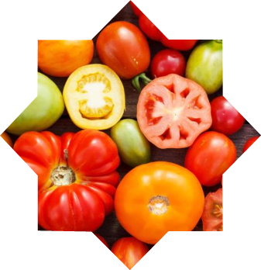
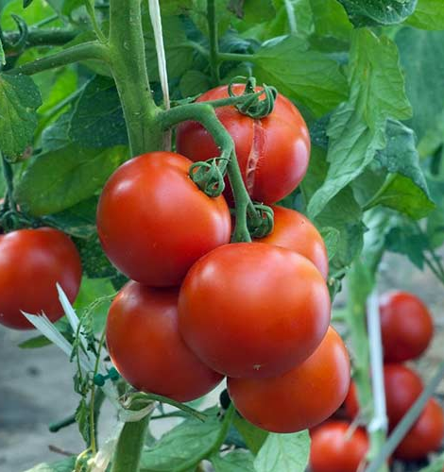
Creation of a modern greenhouse
$ 190,4 thousand
$127,3 thousand
120 tons
Jizzakh region
IRR: 19.0 %
NPV: $123.8 thousand
Export: 50%
Local market: 50%
70 months
Available
LLC “TE TIS”
.+99899 104 97 88

