Slide 1
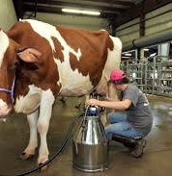
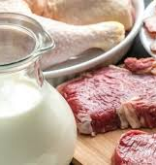
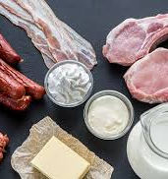
Livestock complex (dairy and meat)
Meat is one of the sources of protein and Beef is in great demand in the local market. The farm will be based on modern cattle breeding technologies. The project will help to meet domestic demand and reduce retail prices and the dairy industry. The food industry, which unites enterprises for the production of various dairy products from milk.
$10.0 mln
$10.0 mln
10’900 tons of milk 150 tons of meat
Tashkent region, Chinaz district
IRR: : 13.9 %
NPV: $4.0 mln
Local market: 100%
54 months
Available
Chinaz district administration
chinoz.t@umail.uz
+99870 5932504

