Slide 1
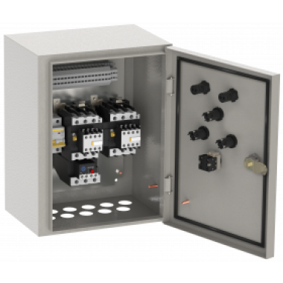
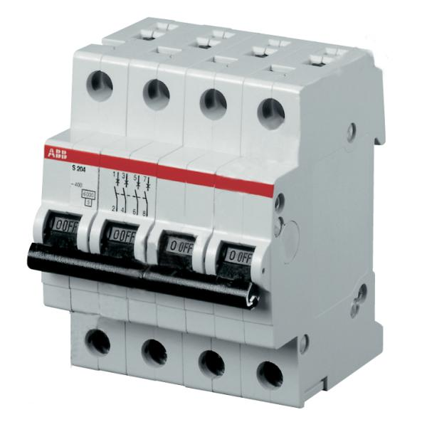
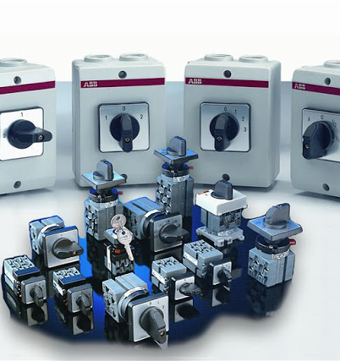
Circuit Breakers and Switches
Localization of production of automatic circuit breakers, household outlets, plugs and other electrical products
$2,1 mln
$1,3 mln
1, 25 mln. units
Free economic zones
Khozarasp
IRR: 15,7 %
NPV: $1,9 mln
Local market: 100%
58 months
Available
Free economic zones Khozarasp

