Slide 1
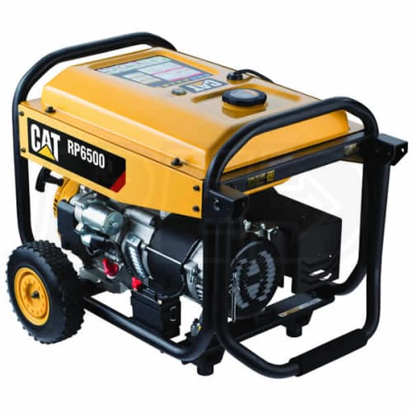
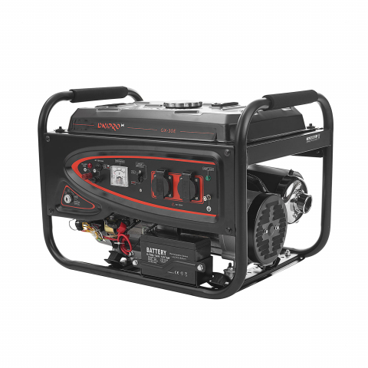
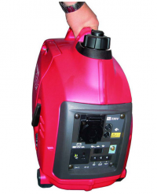
Various generators production
The production of various generators is an attractive business for any investor, given the growing demand in the local and foreign markets. Competitive advantages - the availability of resources, educated staff and low operating costs.
$10.5 mln
$10.5 mln
80 thousand pieces
Tashkent region,
Chirchik city
IRR: 17.3%
NPV: $6.2 mln
Local market: 80%
Export: 20%
48 months
Available
Chirchik city administration
toshkent.t@umail.uz
+99871 1500132

