Slide 1
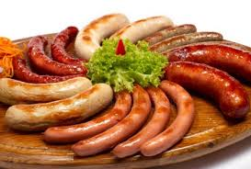
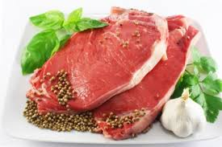
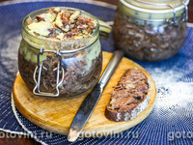
The creation of a livestock complex on breeding cattle of the meat direction
The production of this type of product is a promising direction, since the market of meat products is one of the largest markets for food and other goods. Meat products are in constant demand both among the population and organizations when purchasing meat products for further processing. The project involves breeding of bull calves, production of meat and dairy products.
$ 8.0 mln
$ 6,97 mln
2’450 tons/year
Bukhara region
IRR: 23,1 %
NPV: $ 11,75 mln
Local market: 100%
51 months
Available
Will be clarified

