Slide 1
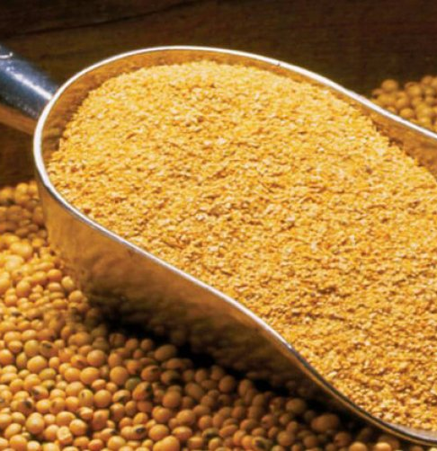
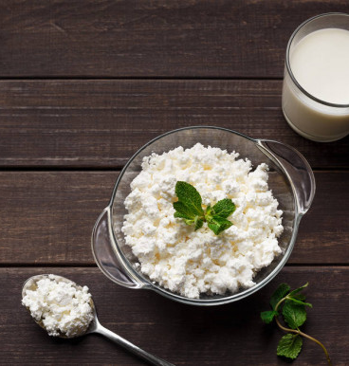
Production of soy protein, soy asparagus, soy curd and soy milk in assortment
$ 7,3 million
$ 4,98 million
5,4 thosand tons per year
Namangan city
IRR 30,7%
NPV: $ 13 million
Export: 50%
Local market: 50%
47 month
Not available

