Slide 1
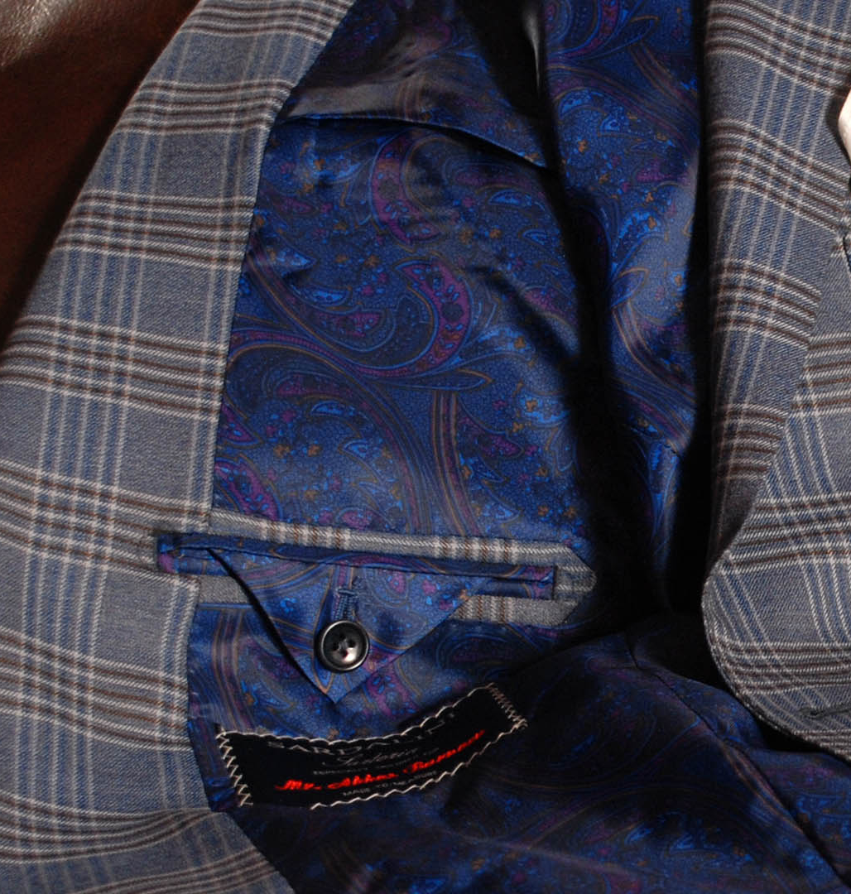
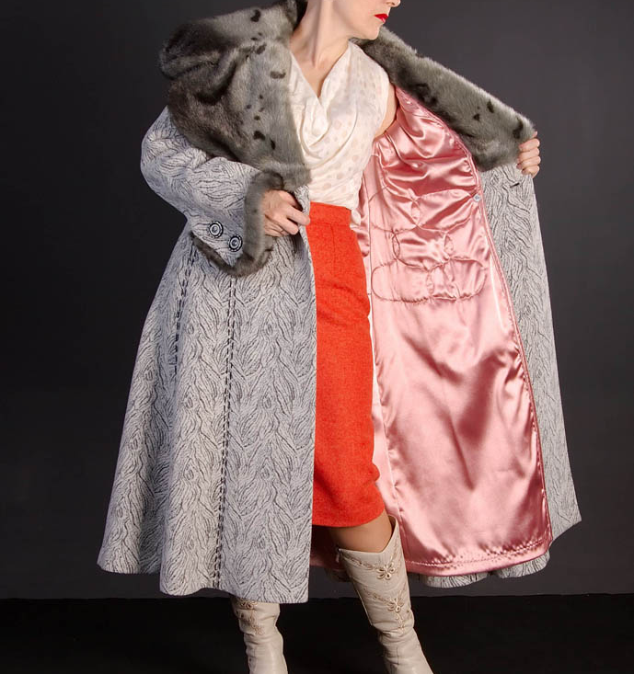
Production of synthetic lining, raincoat and costume fabrics
$ 8,2 mln
$ 5,0 mln
11,8 mln run. meters / year
Namangan region
IRR = 21,6 %
NPV = $ 9,6 mln
Domestic – 30 %
Export - 70 %
61 months
Available
ООО "Grand Suntech Tex"
+998902790100

