Slide 1
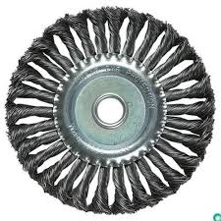
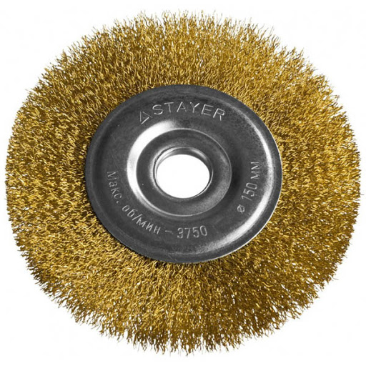
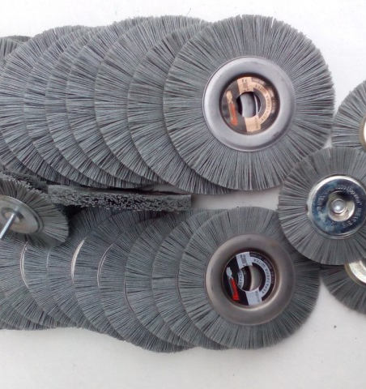
Production of metal brushes for rust cleaning
$0.67 mill
$0.29 mill
0.46 million units
Will be updated
Local market: 50%
Export 50%
IRR: 19.1%
NPV: $0.5 mill
57 months
Available
Will be updated

