Slide 1
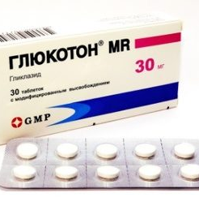
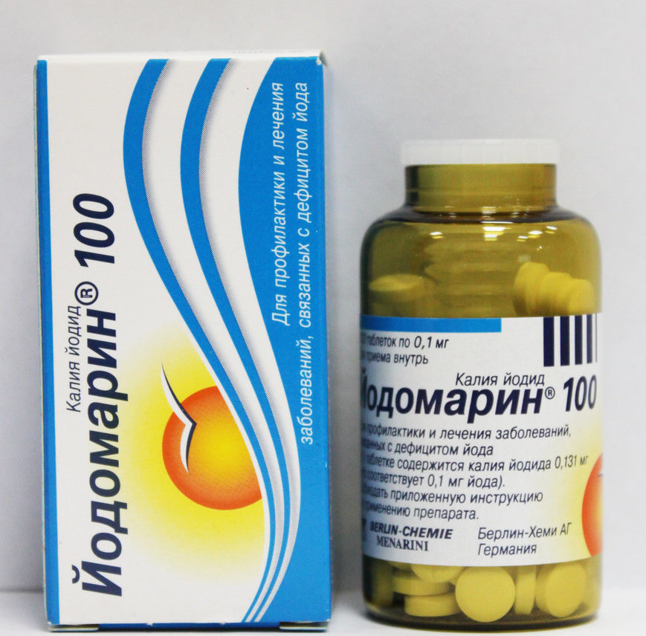
Production of endocrinological drugs
$ 54,4 mill.
$ 47 mill.
5 mill. рc. per year
To be clarified
IRR: 12,8 %
NPV: $ 47,1 mill.
Export: 10 %
Local market: 90 %
65 months
Not available
Agency for the Development of the Pharmaceutical Industry of the Republic of Uzbekistan
farmagentlik@ssv.uz
+998 (71) 203-81-81

