Slide 1
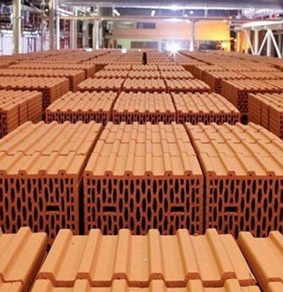
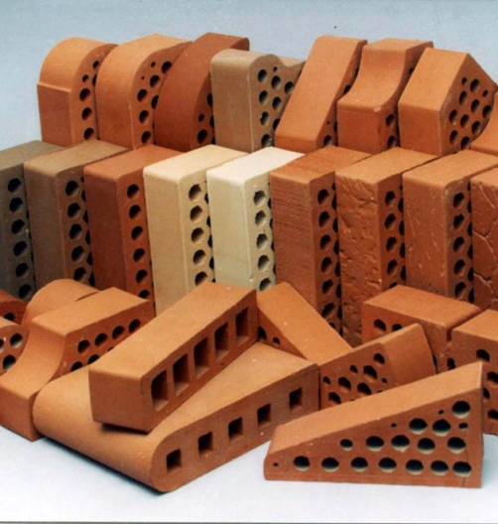
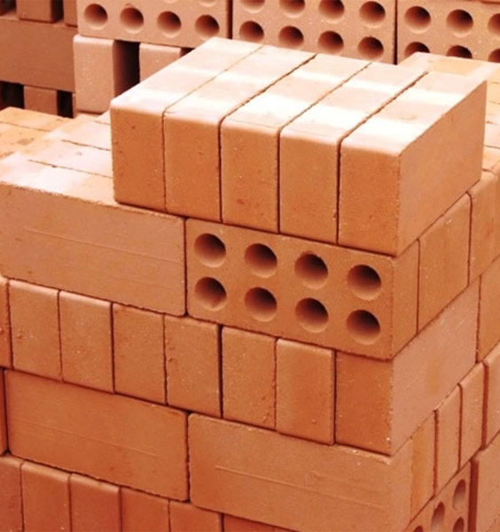
Production of ceramic bricks
$ 1,3 mill.
$ 0,8 mill.
10 million pcs. per year
Tashkent region
IRR: 8,2%
NPV: $ 0,3 mill.
Export: 20%
Local market: 80%
97 months
Not available
«ZAMIN GISHT QURILISH» LTD
+998 98 306 05 03

