Slide 1
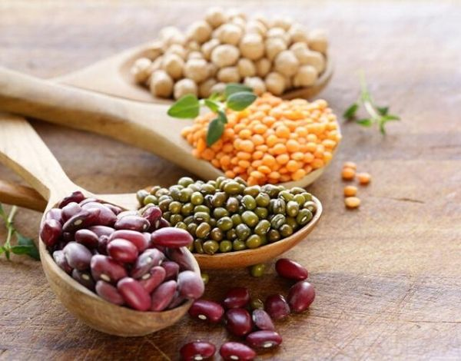
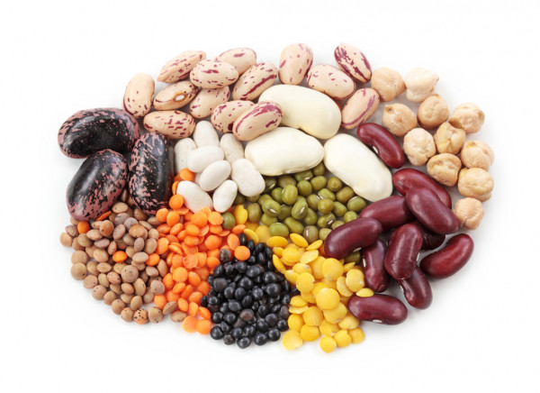
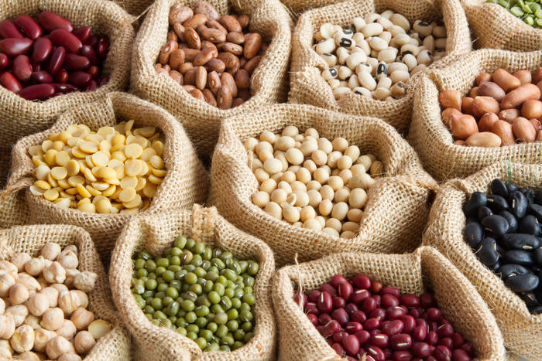
Processing and packaging of legumes
$ 2,6 mln
$ 1,9 mln
15’000 tons
Surkhandarya region
IRR: 25,5%
NPV: $3,62 mln
Export: 80%
Local market: 20%
52 months
Available

