Slide 1
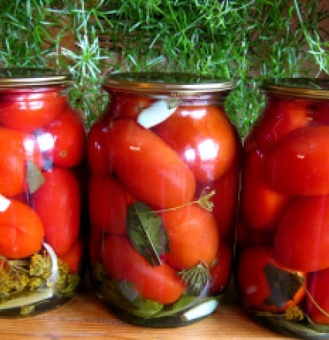
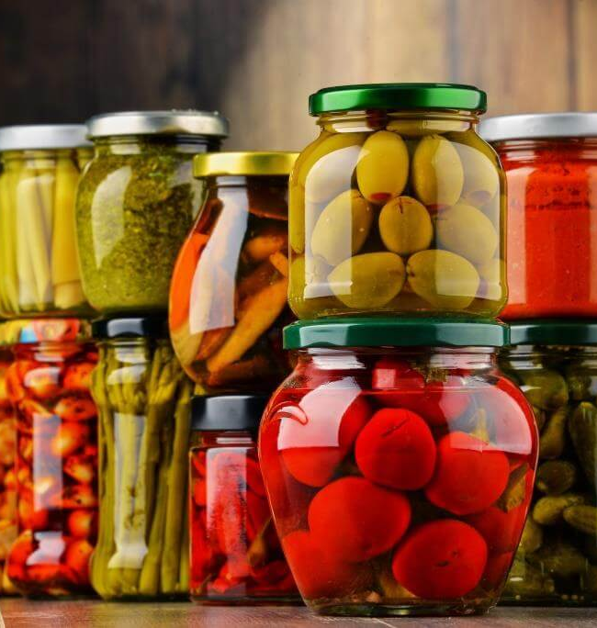
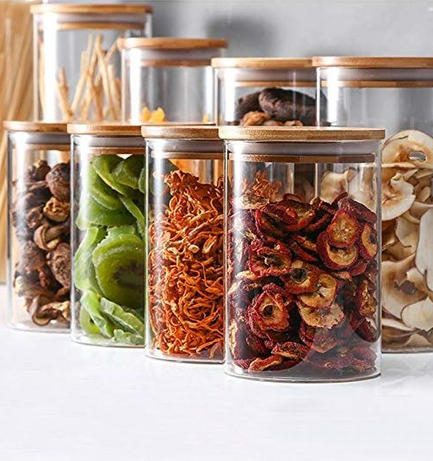
Processing and canning of vegetables
The volume of fruits and vegetable produced in Uzbekistan in 2019 exceeded 19 million ton. While part of these products are consumed and exported fresh, vast amount remains for further processing. Thus, the project can satisfy a growing demand of the food industries for canned fruits and vegetables and preservatives production.
$3.1 mln.
$3.1 mln.
4 mln pcs
Tashkent region, Yangiyul city
IRR 17.8%
NPV $1.9 mln
Export: 100%
45 months
Available
Yangiyul city administration
yangiyol.sh@umail.uz
+99370 6020060

