Slide 1
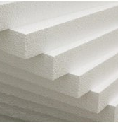
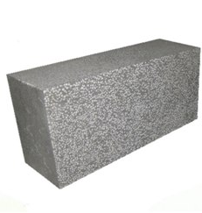
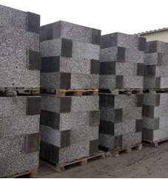
Production of heat-insulating plates from extruded polystyrene foam and polystyrene concrete
Automated line for the production of polystyrene concrete and extruded polystyrene foam
$ 1,3 mil
$ 0,81 mil
60 000 cub. m
Chirokchi Free Economic Zones
IRR: 14.1%
NPV: $ 0,88 mln
Domestic – 100% / 70 %
Export - 0% / 70%
74 months
Available
Chirokchi Free Economic Zones

