Slide 1
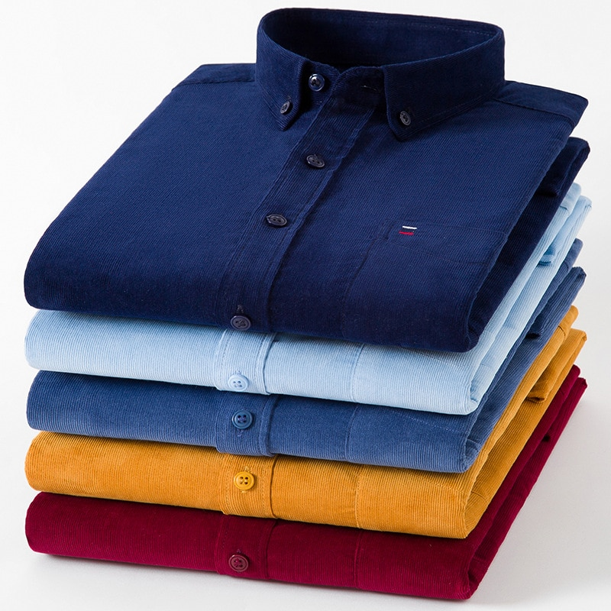
Organization of production of ready-made knitwear and sewing products
285 482 $
110 034 $
549 tons
Surkhandarya region,
Denovsky district
IRR – 48,4 %
NPV - $1,9 million.
Export : 30 %
Local market : 70%
35 months
Available
LLC "Эко Туризм Абу Бакир"
+

