Slide 1
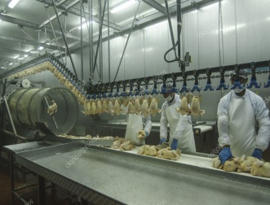
Investment projects of Uzbekistan Poultry Association
Broiler Progenitor Herd of ROSS-308
Project Location
Jizzak Region
PROJECT COST
10,0 mln. $
NEED FOR FOREIGN DIRECT INVESTMENT 5,0-6,0 mln. $
PROJECT INITIATOR`S CONTRIBUTION
25-30%
AVERAGE ANNUAL PRODUCTION 5 mln. Incubation eggs
ANNUAL AVERAGE SALES PROFIT 13,0 MLN. $
ANNUAL NET PROFIT 1,8 MLN. $
EXPORT CIS countries and AFGANISTAN +50%
EXISTING LAND FOR PROJECT
EXISTING INFRASTRUCTURE
NEW WORKERS ENGAGED (+100)

