Slide 1
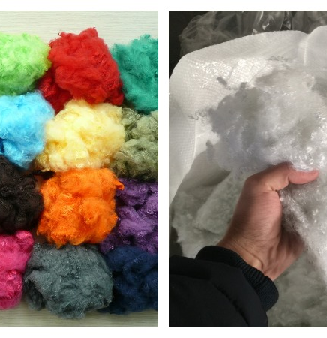
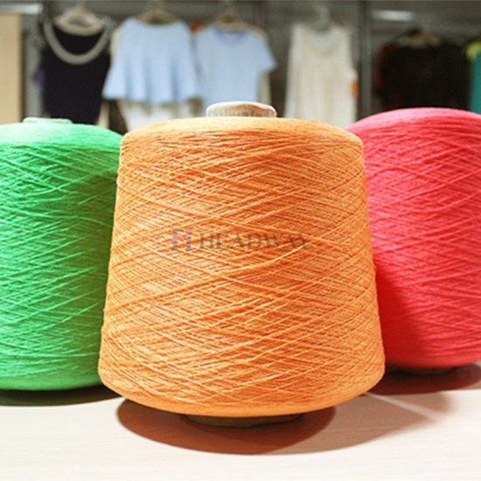
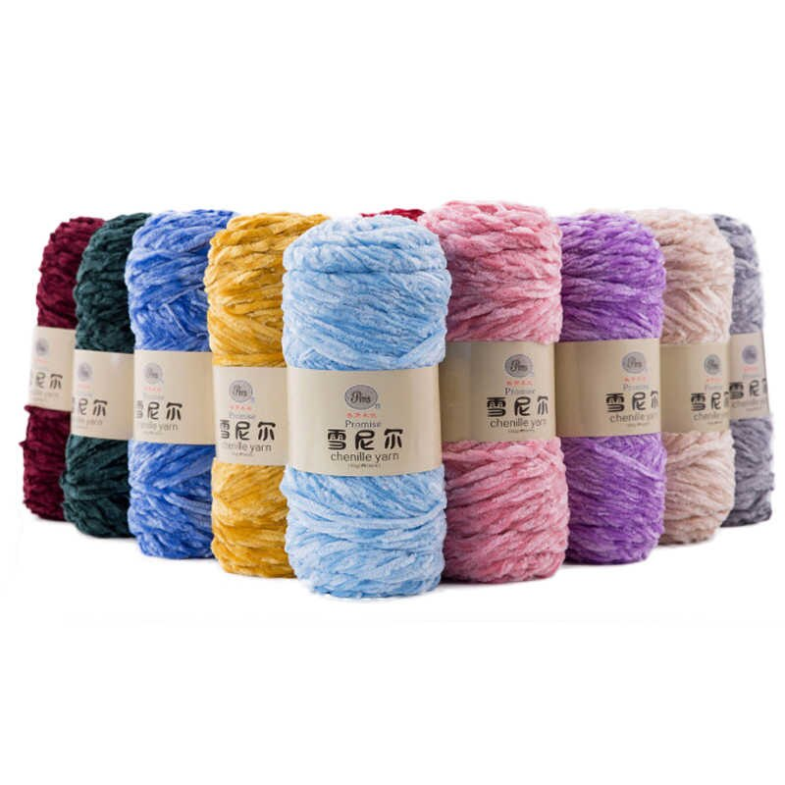
Polyester and micro-polyester production
$26 mln
$22,9 mln
31 thousand tons per year
Andijan region
IRR: 5,4 %
NPV: $1,6 mln
Export: 20%
Local market: 80%
102 months
Available
Angor district administration
durbek.88@gmail.com
+99876 3122069

