Slide 1
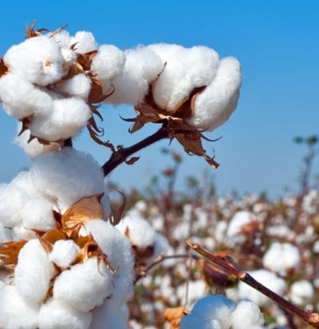
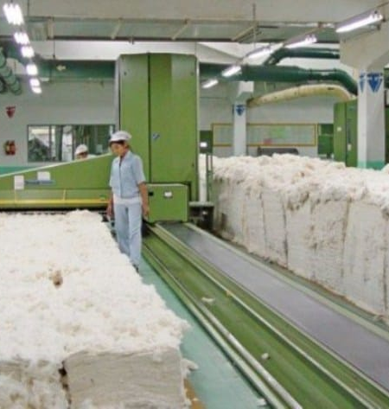
Production of cotton fiber and other products by processing raw cotton
$ 8,1 mill
$ 5,8 mill
15 thousand tons per year
All regions of Uzbekistan
IRR: 10,0 %
NPV: $ 2,1 million
Export: 20%
Local market: 80%
75 month
To be clarified

