Slide 1
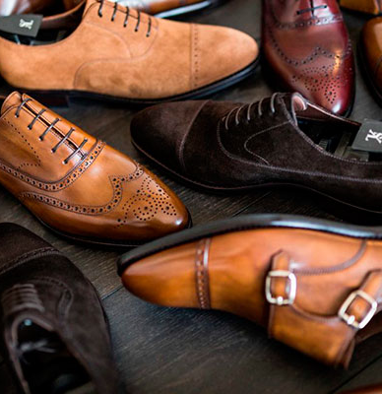
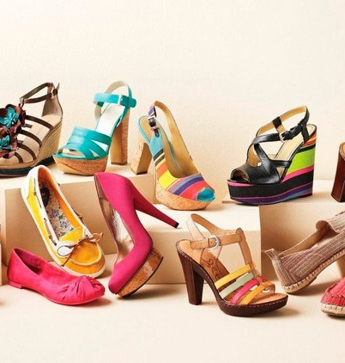
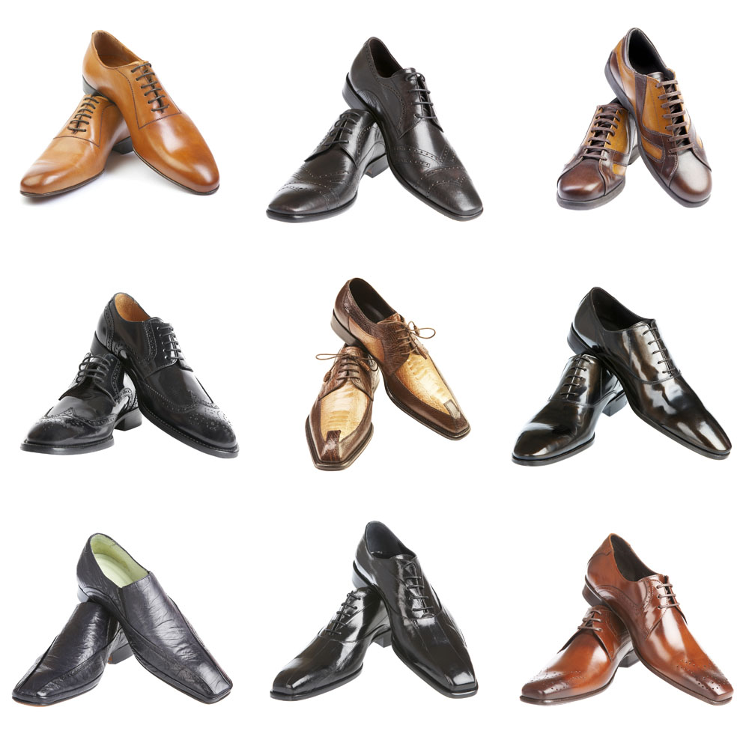
Production of women's and men's shoes
$ 0,77 mill.
$ 0,42 mill.
100 000 pairs per year
Surkhandarya region Sherabad district
IRR: 23,8 %
NPV: $ 0,41 mill.
Export: 20%
Local market: 80%
71 months
Available
LLC«SHER GAZ AVTO»
+998 97 535 10 01

