Slide 1
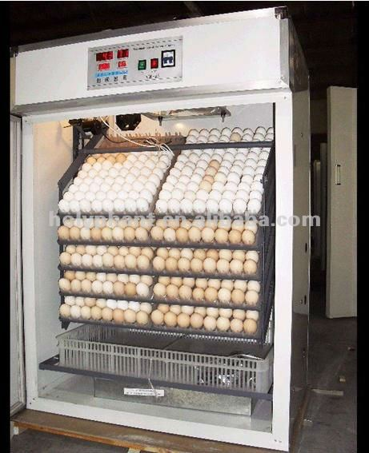
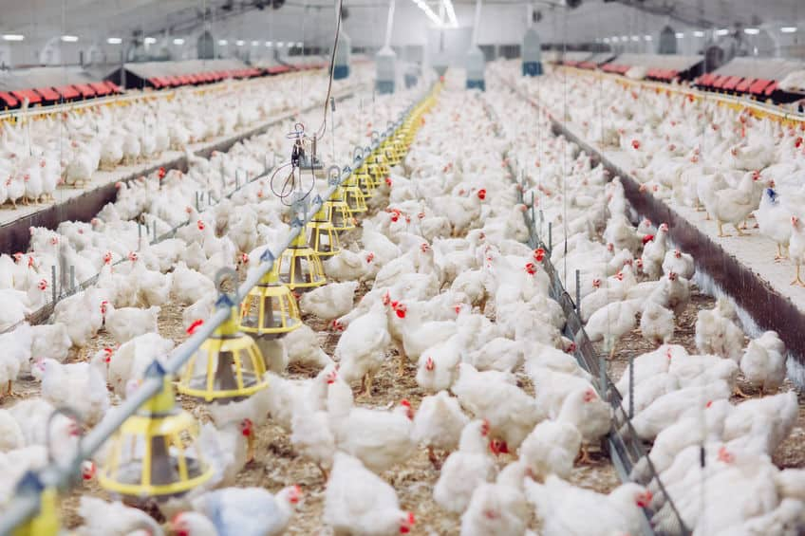
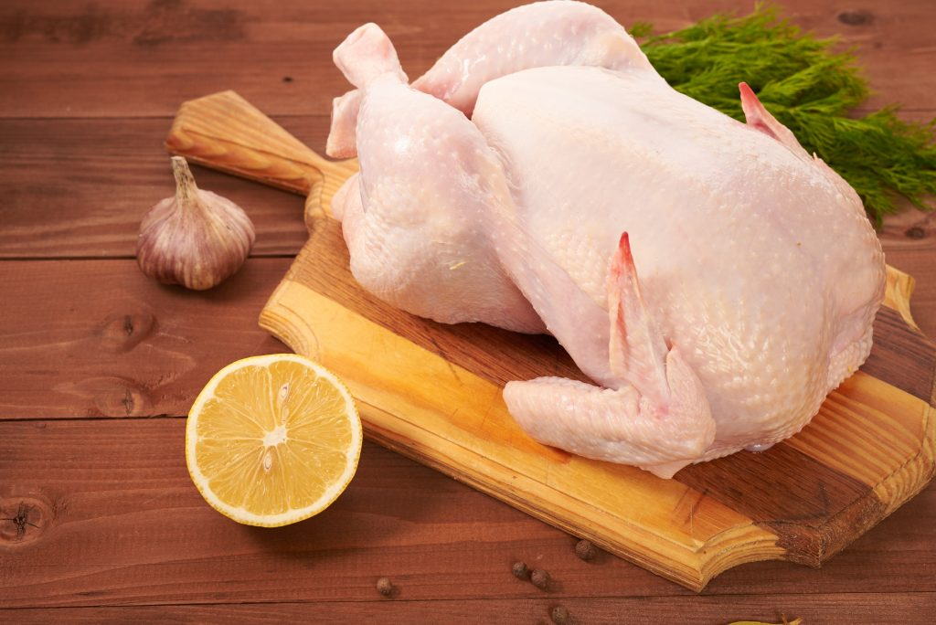
Organization of broiler meat production (600 thousand heads, 700 tons of products)
Filling the market with poultry products and enhancing food security. The supply of fresh poultry meat can create a natural barrier to the import of frozen products and will contribute to the creation of branded domestic chicken products of high quality for retail and catering.
$0.42 mln
$0.28 mln
700 tons
Termez FEZ
IRR: 10,9%
NPV: $0,14 mln
Export: 30%
Local market: 70%
73 months
Available
Termez FEZ
surxoninvest@gmail.com
+99876 3632760

