Slide 1
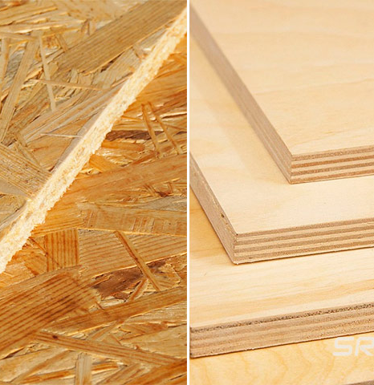
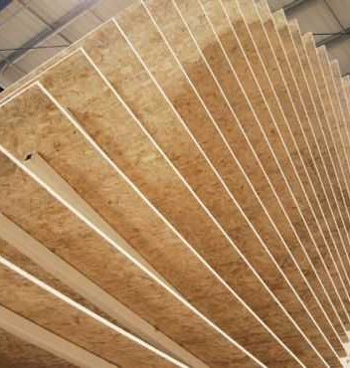
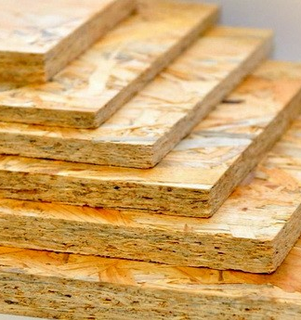
OSB production from wood and agricultural waste.
$ 5,7 mln
$ 4,7 mln
30 thousand cub.m. per year
To be clarified
IRR: 23.0%
NPV: $ 6,3 mln
Export: 50%
Local Market: 50%
53 months
To be clarified

