Slide 1
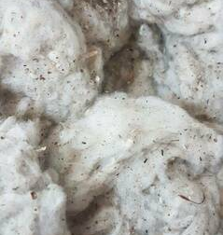
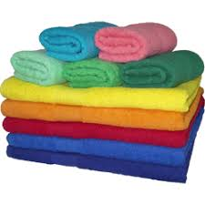
Terry towel
Terry towel production organization
$ 44,4 mln
$ 29,5 mln
terry towel – 4000 ton
direct waste – 2000 ton
All district of Uzbekistan
IRR: 44.4 %
NPV: $ 111.8 mln
Domestic 50 %
Export 50 %
39 months
Available

