Slide 1
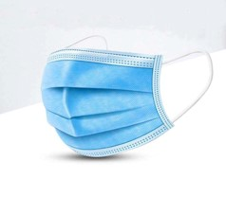
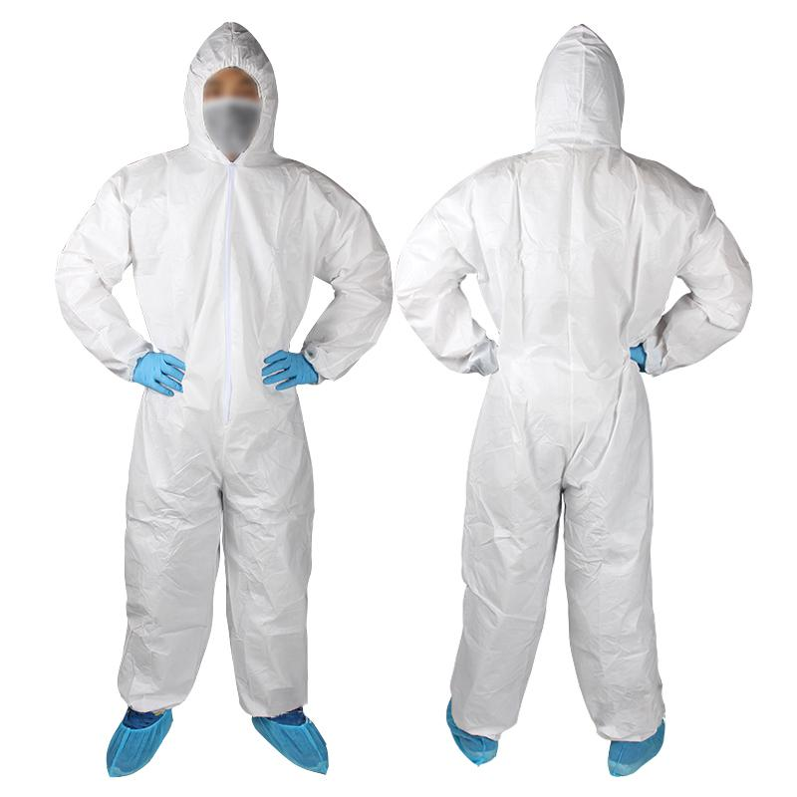
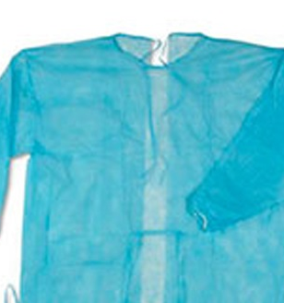
Production of medical masks and overalls
The project provides for the production of medical masks and coveralls to protect physicians and citizens from viruses
$ 2,01 mil
$ 1,28 mil
36 million items
All district of Uzbekistan
IRR: 46,7%
NPV: $ 6,48 mln
Domestic – 100%
35 months
Available
"Avtosnina savdo liyuks" ltd
+998909393425

