Slide 1
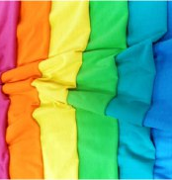
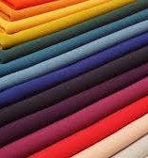
Manufacture of dyed knitted fabric
$ 24,4 mln
$ 15,4 mln.
knitted fabric
4 000 tons
All regions of Uzbekistan
IRR: 14,9 %
NPV: $ 15,20 mln
Domestic – 70%
Export - 30%
71 months
Available
All regions of Uzbekistan

