Slide 1
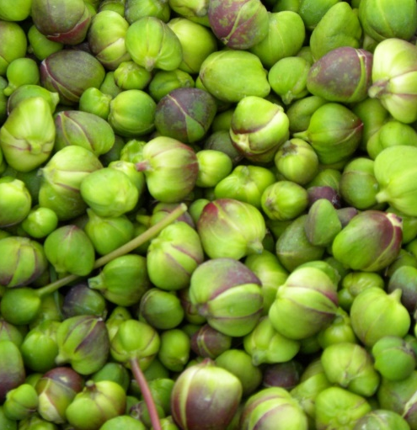
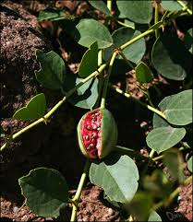
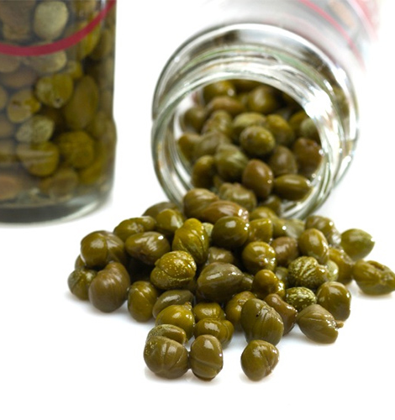
Cultivation and processing of capers
Climate conditions of Uzbekistan are naturally good for growing of high quality capers – the product which is demanded on many markets as a traditional adding of many cuisines, especially Mediterranean. Comparatively small investments versus high financial yields make this project quite attractive for an investor
$581 373
$446 412
$1 068 750
Andijan region, Markhamat district
IRR: 35.7%
NPV: $ 1 642 457
Export: 50%
44 months
Available
LLC “Ershi garden claster”
Yunusov Nodir
+99899 600-66-57

