Slide 1
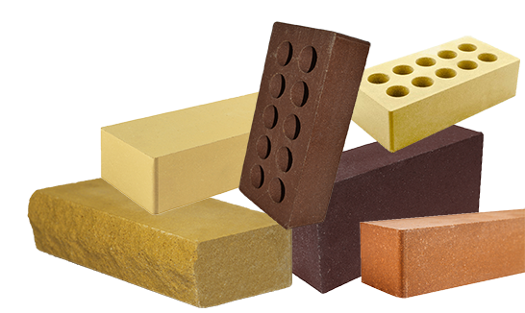
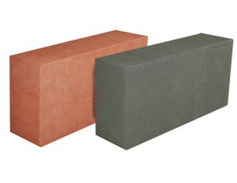
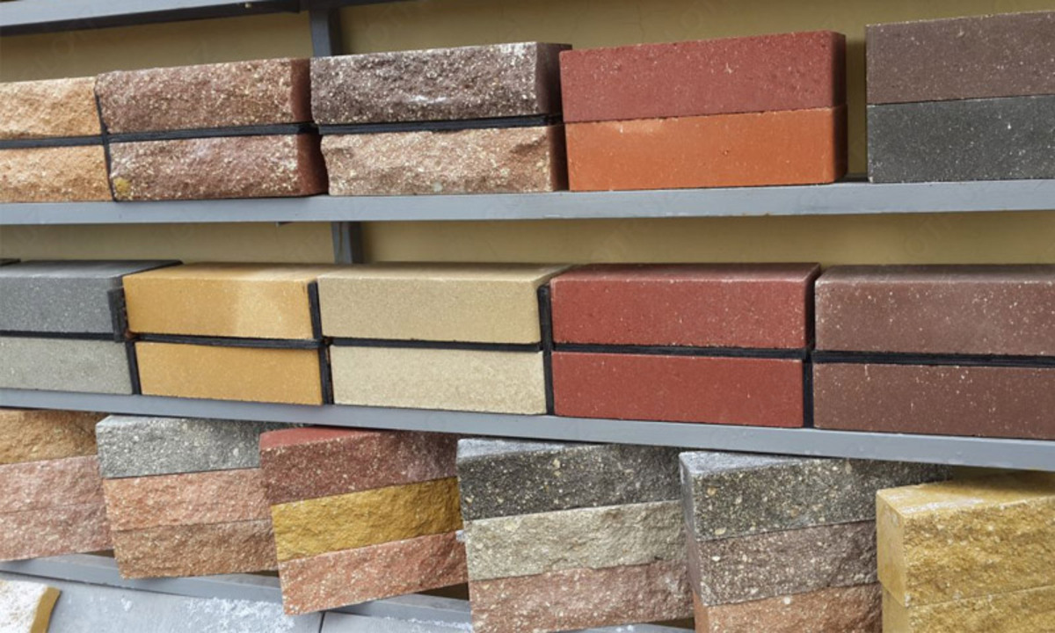
Hyper pressed brick production
Civil construction in the country is facing its rapid development. Quality of construction remains one of the key prerequisites for successful sales. Hyper pressed bricks allow keeping the quality at required level. The project shall benefit from low operating costs and availability of qualified personnel
$0.9 mln
$0.9 mln
4’000 thousand pieces
Tashkent region,
Nurafshon city
IRR: 15.6%
NPV: $0.5 mln
Local market: 100%
51 months
Available
Nurafshon city administration
nurafshon.sh@umail.uz
+99870 7625823

