Slide 1
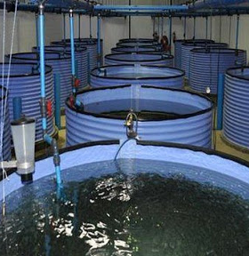
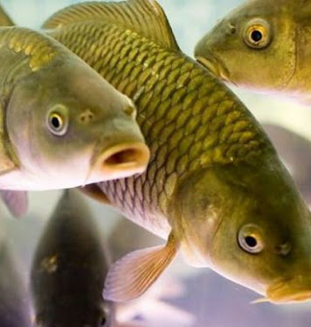
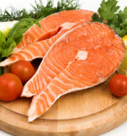
High-intensity fish species cultivation
Fish farming is a growing industry in Uzbekistan. Its is quite attractive for any entrepreneur since conditions allow growing fish and the market demand is there. Yet, intensive fish farming with introduction of new technologies shall benefit more for less operational costs and higher efficiency and productivity.
$0.6 mln
$0.6 mln
200 tons
Tashkent region,
Zangiota district
IRR: 26.9%
NPV: $0.7 mln
Local market: 100%
32 months
Available
Zangiota district administration
zangiota@umail.uz
+99370 9753800

