Slide 1
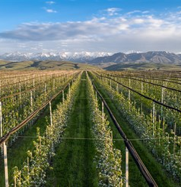
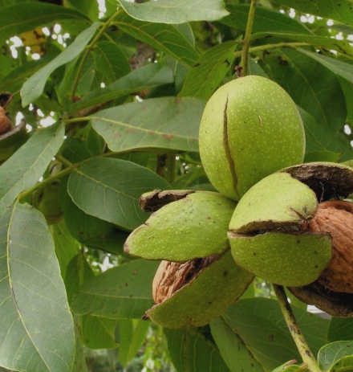
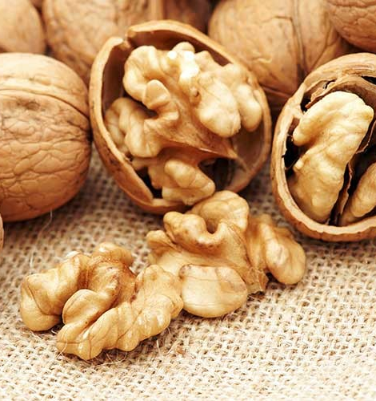
Growing walnuts on 50 hectares
Climate of Uzbekistan gives great opportunities to grow quality walnuts, which is highly demanded on the global market. Competitive advantages - availability of resources, educated personnel and low operating costs.
$0.5 mln
$0.5 mln
400 tons
Tashkent region,
Bustanlik district
IRR: 23.7%
NPV: $0.7 mln
Export: 100%
61 months
Available
Bustanlik district administration
bustonliq.t@umail.uz
+998370 7421793

