Slide 1
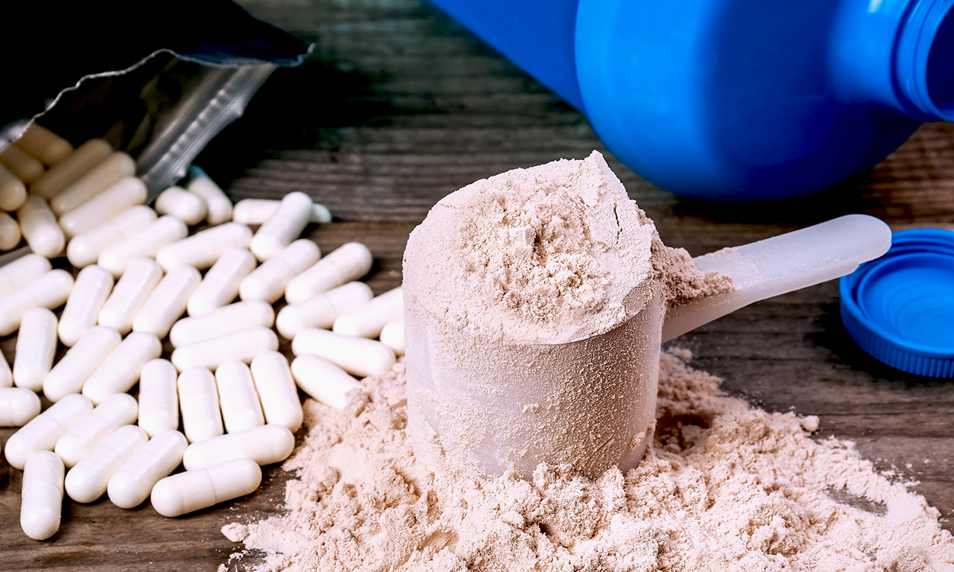
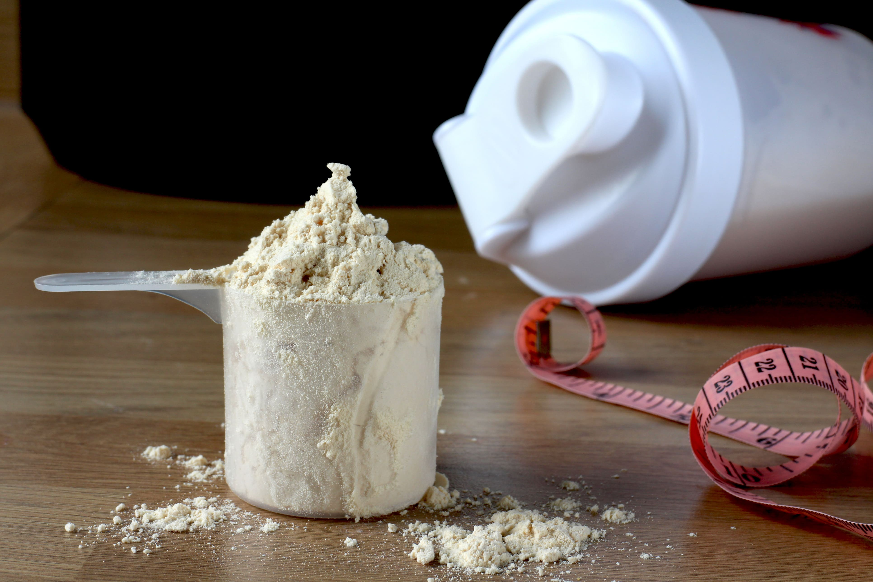
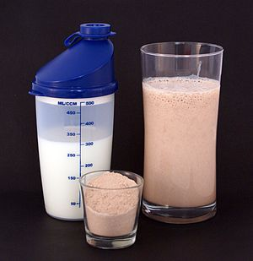
Food additives production (protein, casein, creatine, etc.)
Production of food additives: protein, casein, creatine. The production of dietary supplements for athletes is now a very profitable business, because the demand for it is growing day by day.
$1.3 mln
$1.3 mln
250 tons
Tashkent region,
Tashkent district
IRR: 25.8%
NPV: $1.5 mln
Export: 50%
Local market: 50%
33 months
Available
Tashkent district administration
toshkent.t@umail.uz
+99871 2035522

