Slide 1
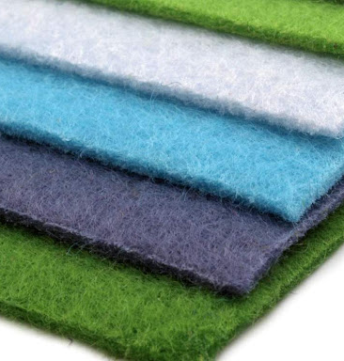
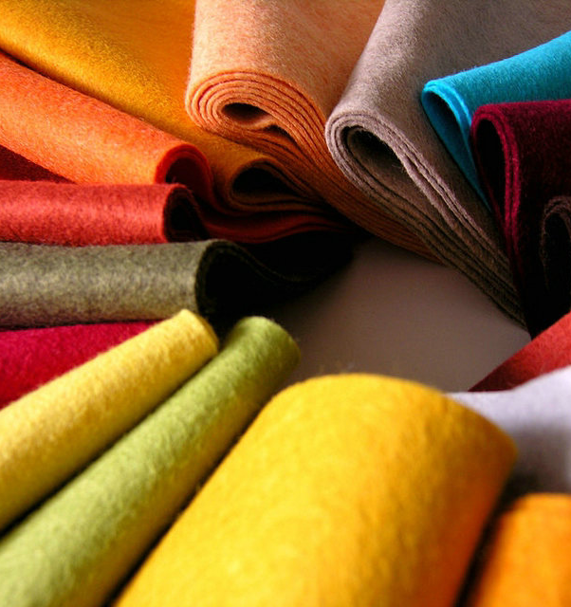
Organization of felt production
$ 609 thousand
$ 609 thousand
50 000 kg per year
Andijan region, Bulakboshi district
IRR: 20,2%
NPV: $ 452 thousand
Export: 50%
Local market: 50%
52 month
To be Clarified

