Slide 1
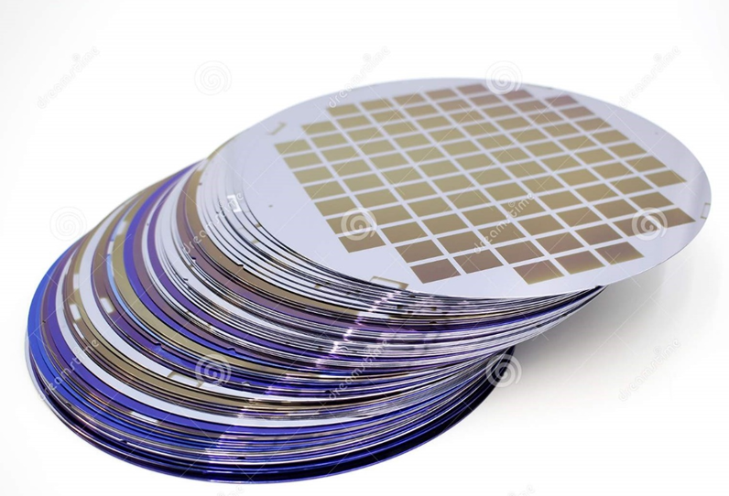
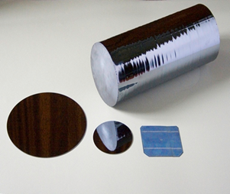
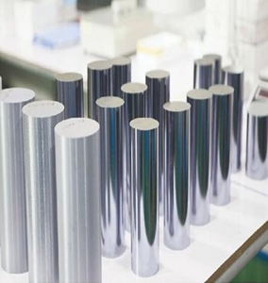
Production of monocrystalline silicon for solar cells
$ 374 thousand
$ 374 thousand
675 thousand per year
Navoi city and all regions of Uzbekistan
IRR: 31,5%
NPV: $ 686 thousand
Export: 98 %
Local market: 2 %
45 month
Not available

