Slide 1
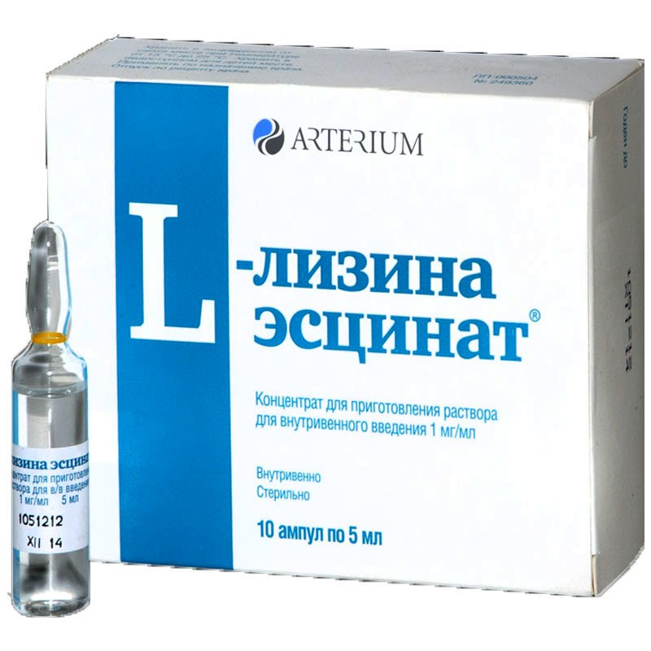
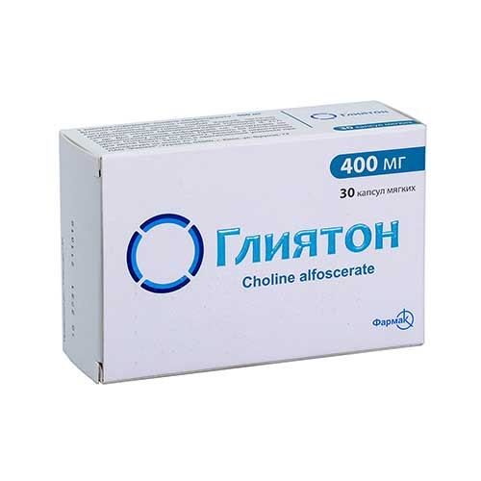
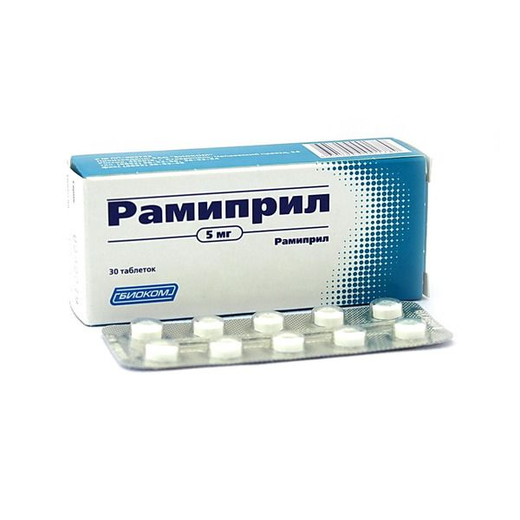
Manufacturing of medicines (cardiology, neurology)
$ 30.1 miln
$ 24,6 miln
30 miln. pcs per year
Tashkent city
IRR: 21,9%
NPV: $ 43,8 miln
Export: 10 %
Local market: 90 %
59 months
Not available
Uzpharm agency
farmagentlik@ssv.uz
+998 (71) 203-81-81

