Slide 1
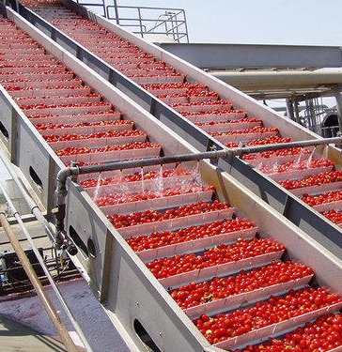
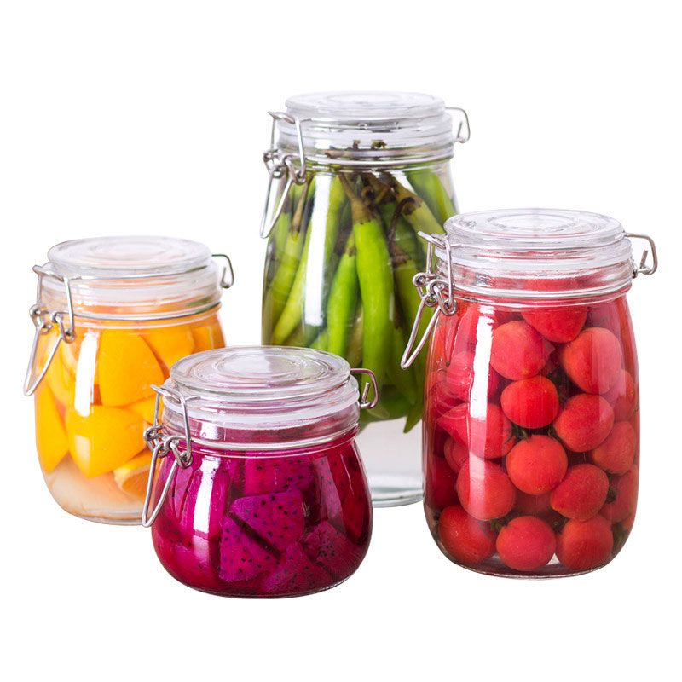
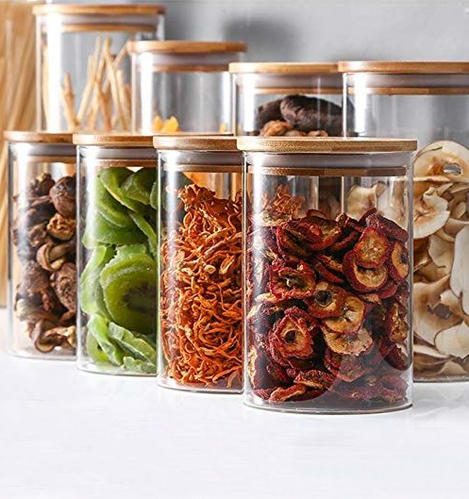
Dried fruits
The volume of fruits and vegetable produced in Uzbekistan in 2019 exceeded 19 million ton. While part of these products are consumed and exported fresh, vast amount remains for further processing. The project can satisfy a growing demand from food industries for canned and packed fruits and vegetables.
$3 mln
$3 mln
20’000 tons
Tashkent region,
Bustanlik district
Export: 100%
IRR: 36.4%
NPV: $5.6 mln
24 months
Available
Bustanlik district administration
bustonliq.t@umail.uz
+998370 7421793

