Slide 1
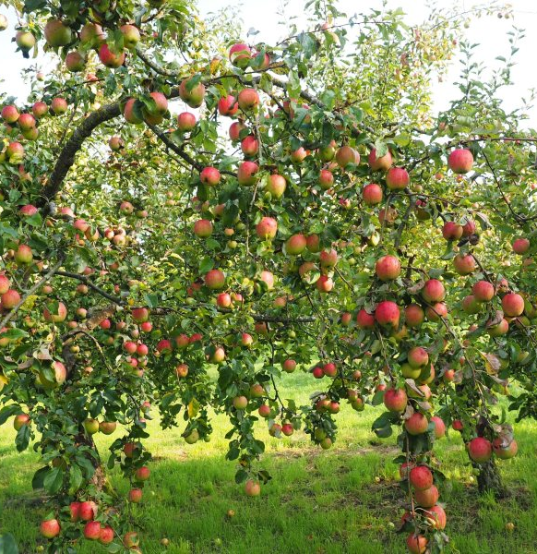
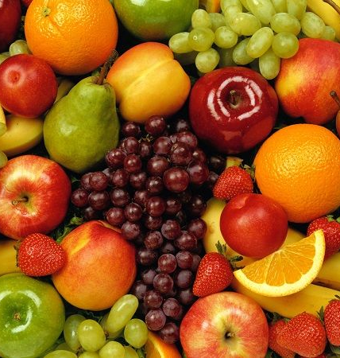
Creation of an intensive orchard and cultivation of fruit and vegetable products
$6,37 mill
$4.34 mill.
10,96 thousand tons per year
Jizzakh region, Zaamin district
IRR: 22.1%
NPV: $7,57 mill.
Export: 50%
Local market: 50%
58 months
Will be available
"Chopon" Farming
+998 95-145-10-14
+998-99-985-01-53

