Slide 1
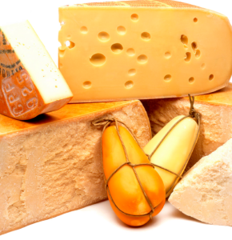
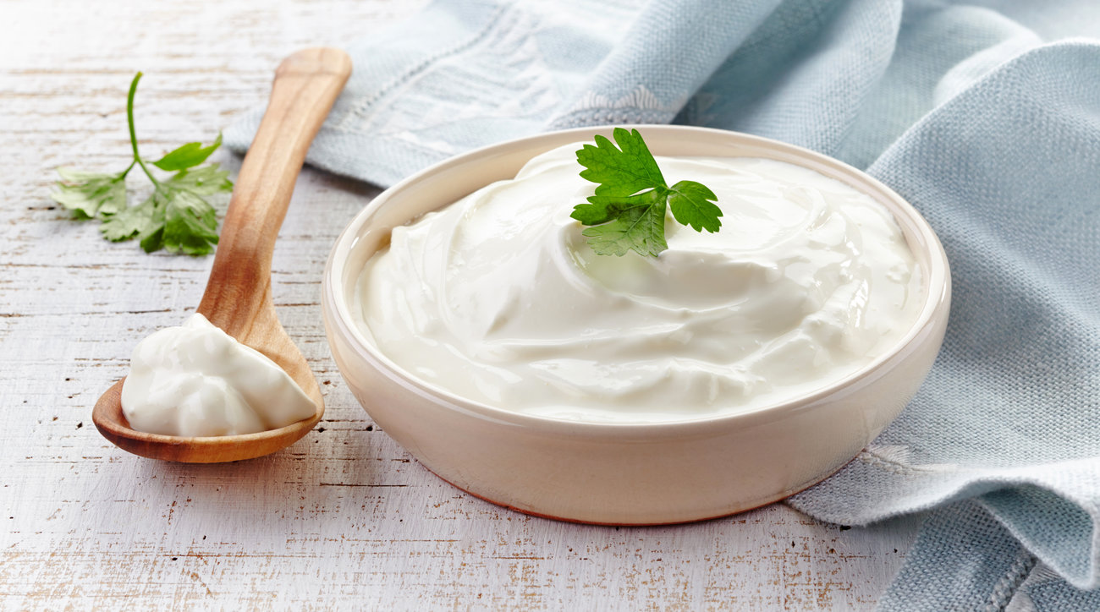
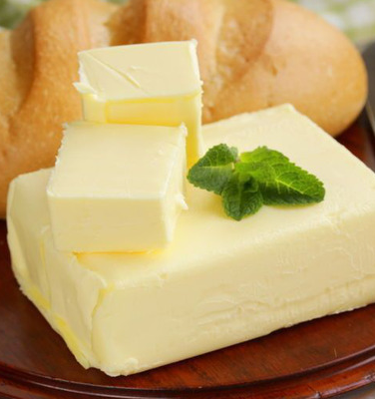
Creation of a livestock complex for milk processing and production of packaged cheese and butter products
Dairy products are important foods. The production of high-quality dairy products and the preservation of dairy products require certain knowledge in the field of milk production and processing technology, identification, types and methods of packaging, labeling, transportation and storage.
$27,6 mln
$25,6 mln
14 734 tons/year
Termez FEZ
IRR: 15,5%
NPV: $14,8 mln
Export: 20 %
Local market: 80%
73 months
Available
Termez FEZ
surxoninvest@gmail.com
+99876 3632760

