Slide 1
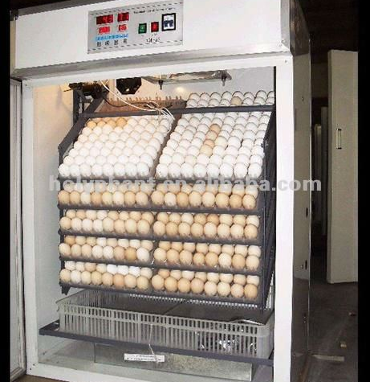
Creation of a chicken egg poultry farm
The saturation of the market with essential products and reducing its value. The modern domestic production of poultry and eggs does not satisfy the domestic consumption of poultry products. Dynamic growth in the consumption of poultry meat and eggs.
$0.23 mln
$0.17 mln
3 mln peices /year
Bukhara region
IRR: 17,0 %
NPV: $ 0,15 mln
Local market: 70%
Foreign market: 30%
59 months
Available
Wil be clarified

