Slide 1
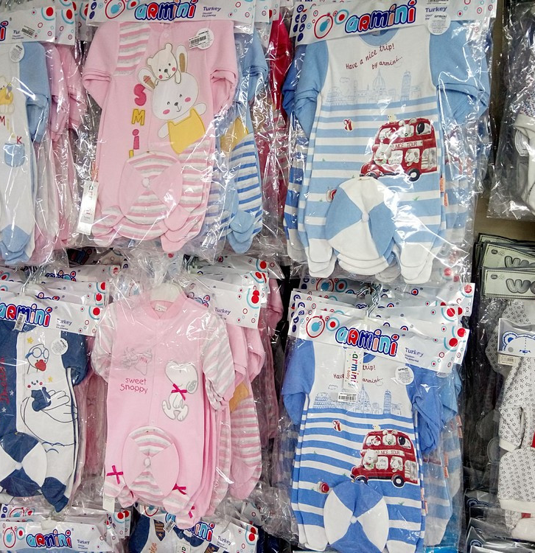
Production of clothes for babies in stock
Uzbekistan is famous for its cotton products, which have traditional and looking for new alternative markets. Proposed project is an attractive business proposal. Production is based on the local resource base and can benefit from the availability of qualified personnel and low operational costs.
$1.2 mln
$1.2 mln
720’000 pieces
Tashkent region,
Chirchik city
IRR: 33.3%
NPV: $2 mln
Local market: 50%
Export: 50%
38 months
Available
Chirchik city administration
chirchiq.sh@umail.uz
+99870 7162435

