Slide 1
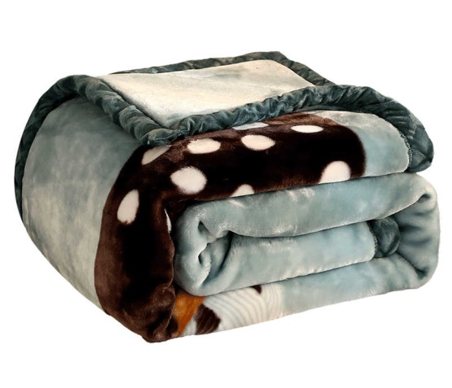
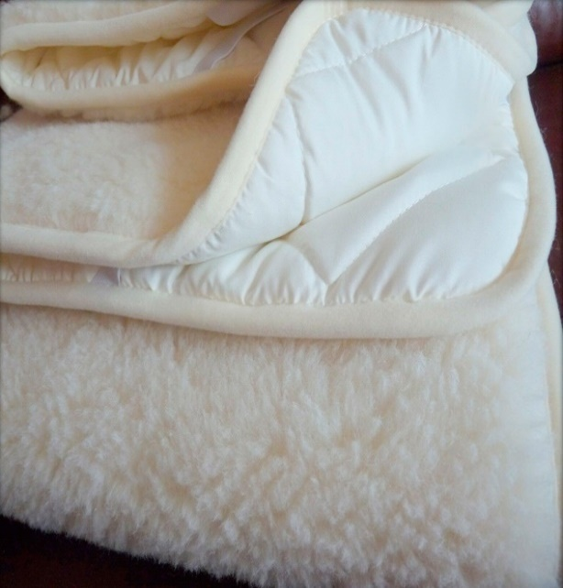
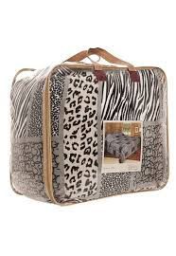
Blanket from natural wool and synthetics production
The demand for blanket is growing rapidly. This product is in demand in the market and has the potential to export to neighboring countries. Competitive advantages - the availability of resources, educated personnel and low operating costs.
$18 mln
$13,9 mln
1800 tons per year
Fergana Region
Kokand FEZ
IRR: 16,5%
NPV: $12,02 mln
Local: 30%
Export: 70%
64 months
Available
Kokand FEZ

