Slide 1
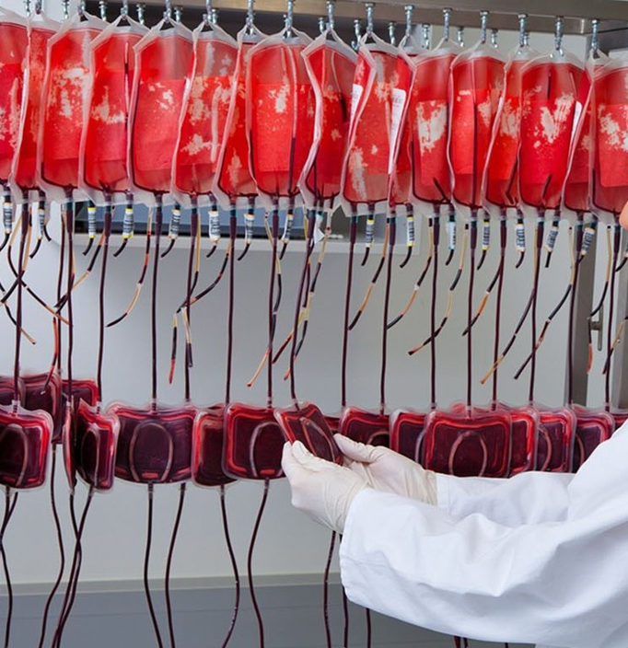
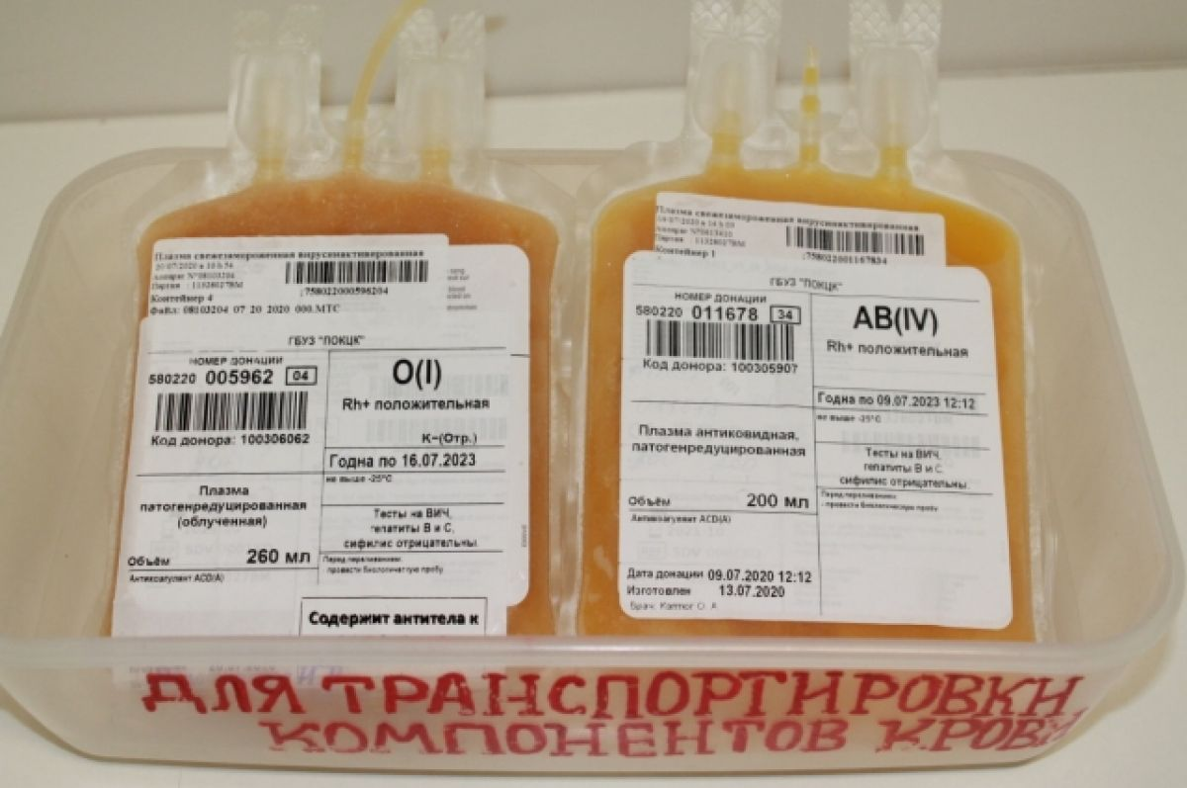
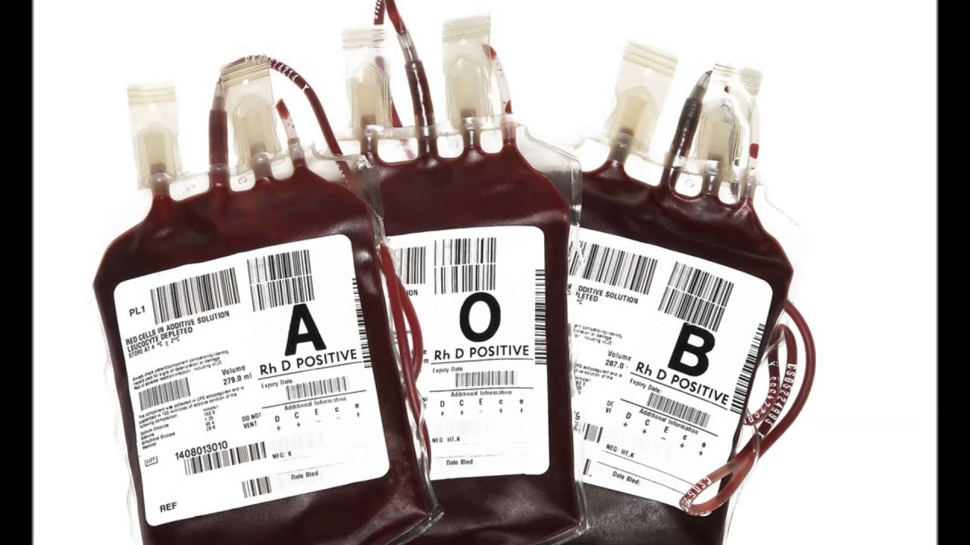
Production of drugs based on blood plasma
$ 59,3 miln
$ 50,0 miln
100 miln pcs per year
Tashkent city
IRR: 10,2%
NPV: $ 23,3 miln
Export: 90,0 %
Local market: 10 %
87 months
Will be available
Farm agency
998 (71) 203-81-81

