Slide 1
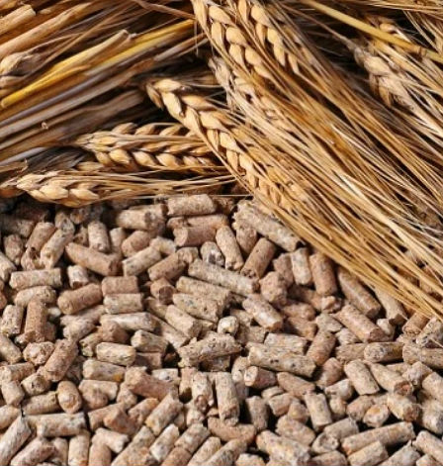
Bone flour production
Cattle breeding has become a national program in Uzbekistan. To support fast growing sector fodder industry should develop simultaneously. The project should be based on modern meat processing technologies, where almost 100% of an animal is utilized for fodder and fertilizers production. The assessment shows a continuously growing demand for this product on the local market
$0,7 mln
$0,7 mln
3 000 tons of compound feed
Sirdarya region, Gulistan city
IRR 50,51%
NPV $2,1 mln
Local market
16 months
Available
Gulistan city administration
almanov1990@bk.ru
+99867 2250373

