Slide 1
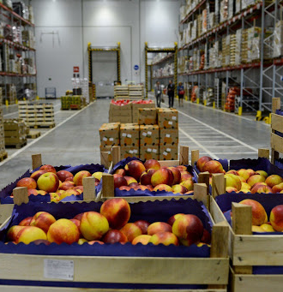
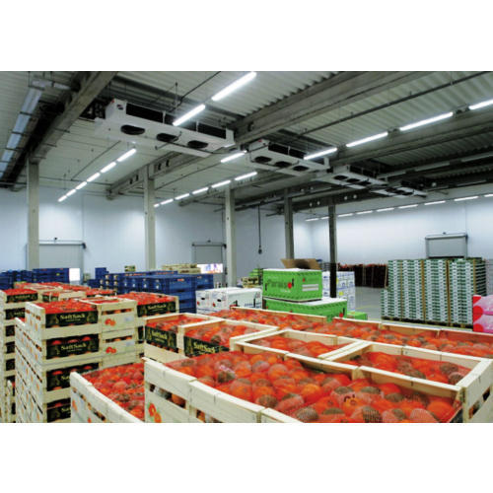
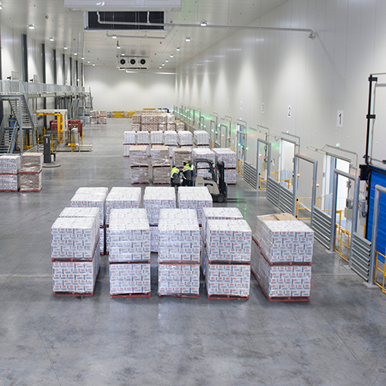
The logistics center for agricultural products
Construction of logistic center for agricultural products with storage, processing and packaging capacities for about 50’000 tons products per year. Location of this Centre shall allow covering high demand for agricultural products on the local market as well as for exports, primarily to Afghanistan. Other competitive advantages - availability of resources, educated personnel and low operating costs.
$102.6 mln
$102.6 mln
50’000 tons of vegetables and fruits
Surkhandarya region,
Termez district
IRR: 10.4 %
NPV: $22.0 mln
Export: 100%
64 months
Available
Termez district administration
surxoninvest@gmail.com
+99876 3632760

