Slide 1
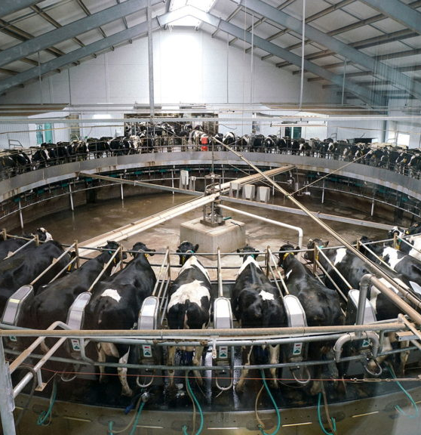
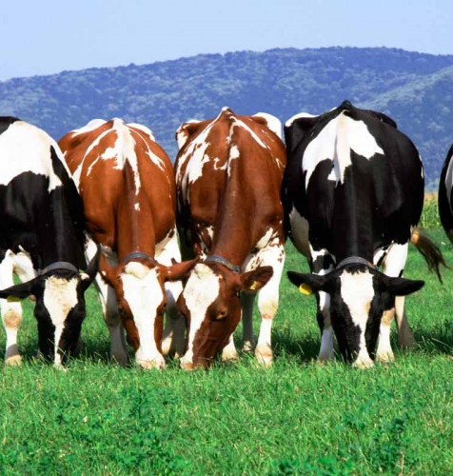
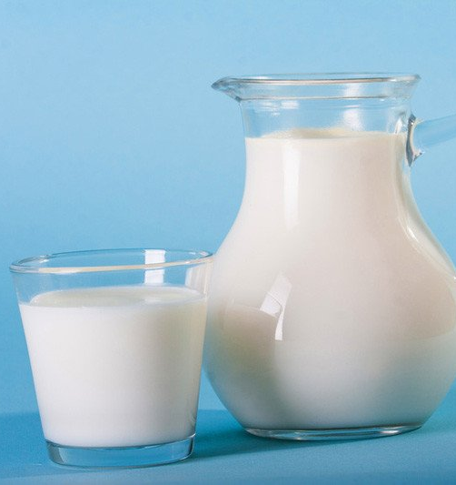
Organization of a dairy cattle breeding complex
Growing demand for a fresh milk and dairy products on the domestic market provide a significant place for a supply chain for a milk farm. The farm shall also benefit from governmental cattle breeding support program. Availability of educated personnel and low operational costs are also advantageous for a project.
$10,0 mln
$10,0 mln
11’050 tons of milk
Republic Of Karakalpakstan, Kungrat district
IRR: 13,9%
NPV: $3,9 mln
Local market: 100%
54 months
Available
Kungrat district administration
qungirot@karakalpakstan.uz
+99861 3120960

