Slide 1
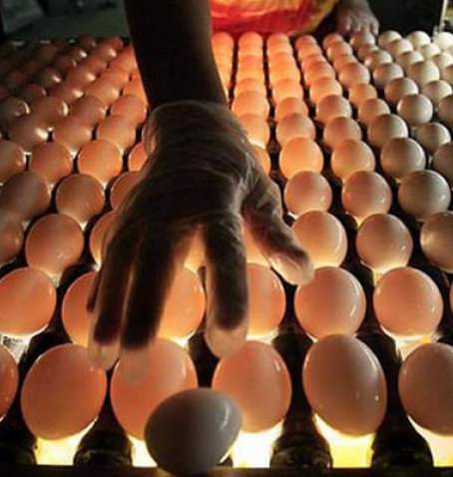
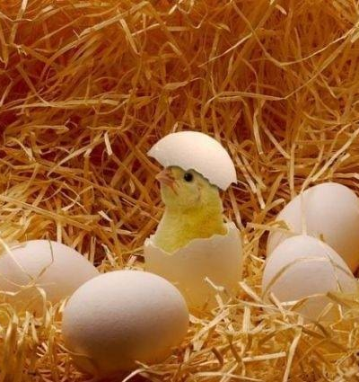
Poultry farming
Medium to large scale poultry farm. This project gains from high demand from the growing poultry industry in Uzbekistan. It can also benefit from export possibilities to neighboring countries.
$4,5 mln
$4,5 mln
5’000’000 chickens
Surkhandarya region,
Termez district
IRR: 31,5%
NPV: $6,8 mln
Export: 50%
Local market: 50%
28 months
Available
Termez district administration
surxoninvest@gmail.com
+99876 3632760

