Slide 1
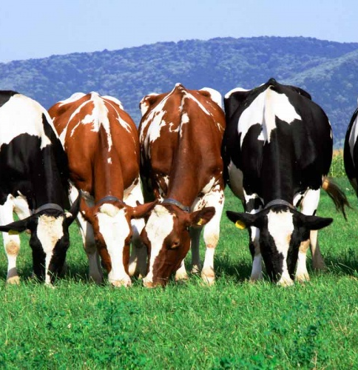
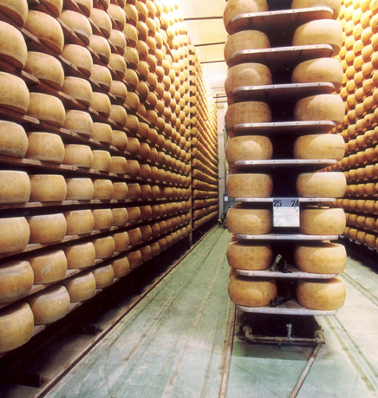
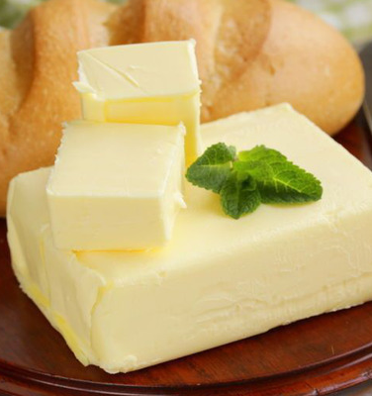
Establishing the line of milk processing aside with packaged butter and cheese
Production of milk and various dairy products, like cheese and butter. The demand for these products on the local market is quite huge, supported by the export potentials to neighboring courtiers. Competitive advantages - availability of resources, educated personnel and low operating costs.
$37,6 mln
$37,6 mln
4’000 tons/year
Jizzakh region
Mirzachul district
IRR: 29,5%
NPV: $51,8 mln
Export: 40%
Local market: 60%
29 months
Available
Mirzachul district administration
e.akramov@inbox.uz
+99872 3122111

