Slide 1
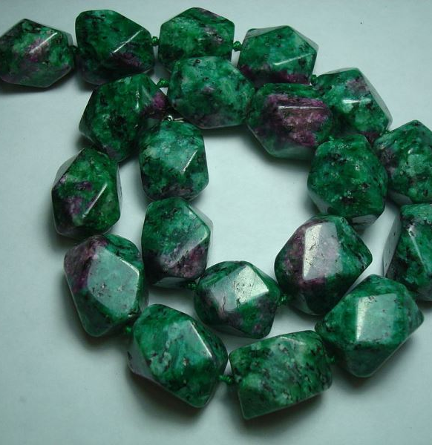
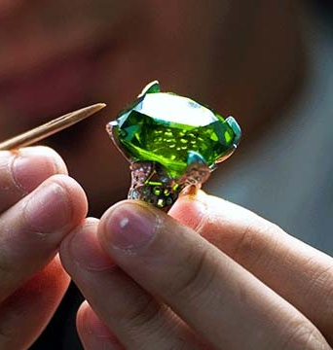
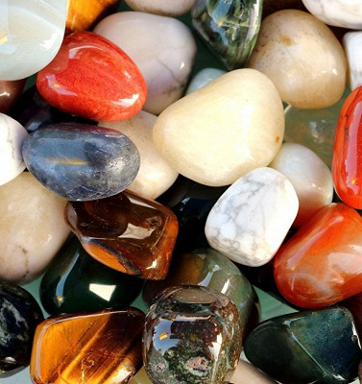
Semiprecious stones processing and jewelry manufacturing
It is a long standing tradition in Uzbekistan based on reach history of jewelry production, especially in cities like Bukhara and Samarkand. The local market demand is supported by the growth of the tourists visiting Uzbekistan. Production is based on local resource base, supported by design and vocational training facilities.
$0,3 mln
$0,3 mln
74’880 pcs souvenirs
Navoi region,
Uchkuduk district
IRR: 43%
NPV: $1 mln
Local market: 100%
24 month
Available
Uchkuduk district administration
uchquduq@nv.uz
+99879 5933100

