Slide 1
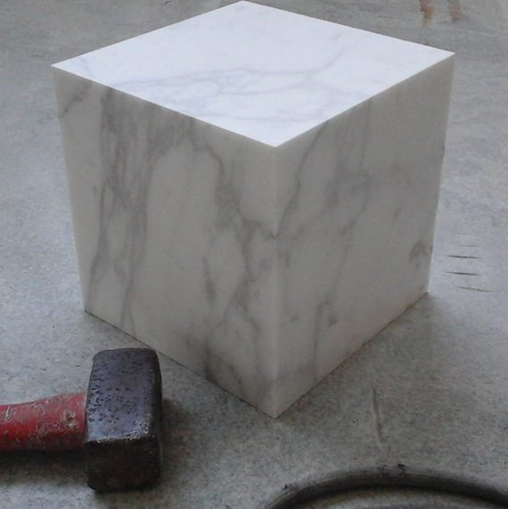
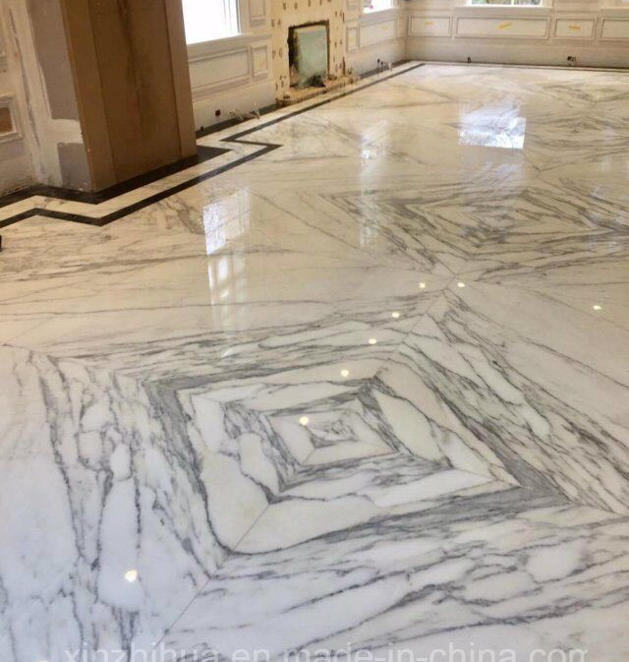
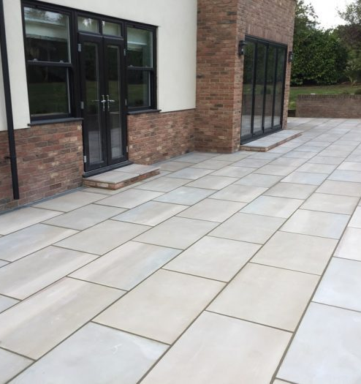
Marble mining and processing
Marble is widely used in construction in Uzbekistan. The country is reach in marble and other decorative stones deposits. The market demands quality products which could be only produced using modern, state-of-art equipment. High quality products have also potential for export to a neighboring countries making proposed project quite an interesting endeavor.
$2.2 mln
$2.2 mln
60’000 square meters of marble
Kashkadarya region,
Kitab district
IRR: 14,2%
NPV: $0,9 mln
Export: 20%
Local market: 80%
22 months
Available
Kitab district administration
invest7uz@gmail.com
+99875 2210237

