Slide 1
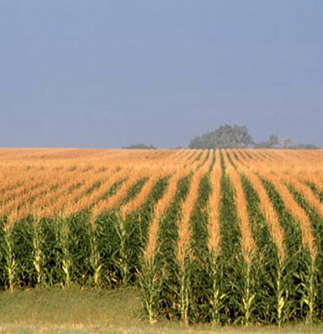
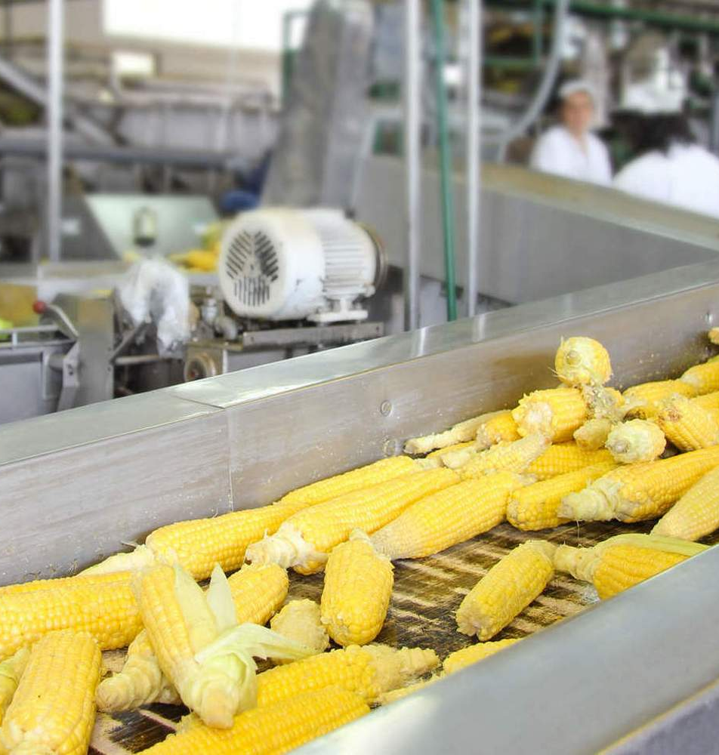
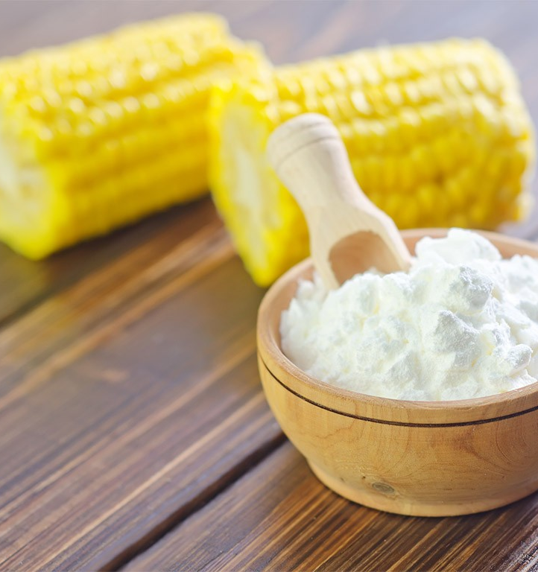
Production of cornstarch
This product is always at high demand by the local and international food industry. Additional benefits for locally produced products is possibility to get “green” certificates for a produced corn
$1,4 mln
$1,4 mln
1,100 tons of corn starch
Republic Of Karakalpakstan, Chimbay district
IRR: 8,6%
NPV: $0,7 mln
Local market: 100%
70 months
Available
Chimbay district administration
chimboy@karakalpakstan.uz
+99861 4440010

