Slide 1
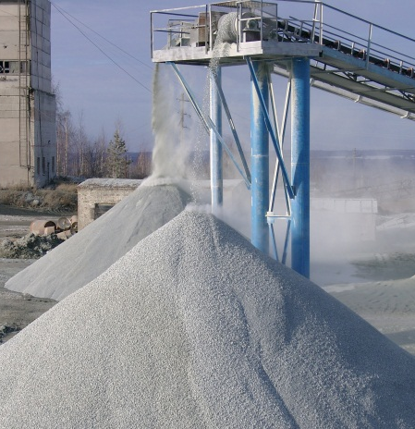
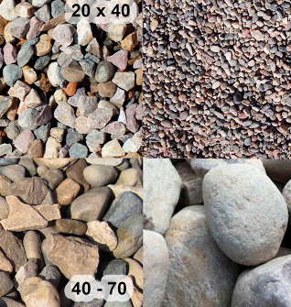
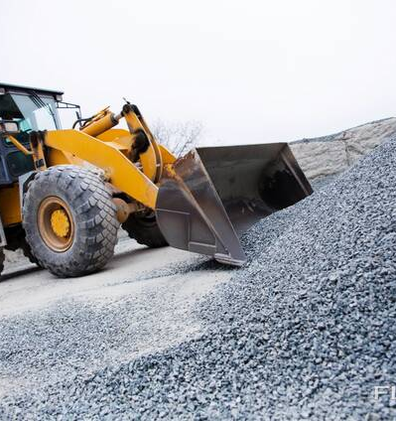
Production of crushed stone
Direct application of a crushed stone in construction is well known, as well as it is used as a key component for further production of various construction materials. Thus, it is highly demanded on the local market. Production is based on local resource base mainly located near main construction sites.
$2,3 mln
$2,3 mln
39 600 tons
crushed stone
Navoi region
Tamdy district
IRR: 15%
NPV: $1,0 mln
Local market: 100%
48 months
Available
Tamdy district administration
tomdi@nv.uz
+99879 5821316

