Slide 1
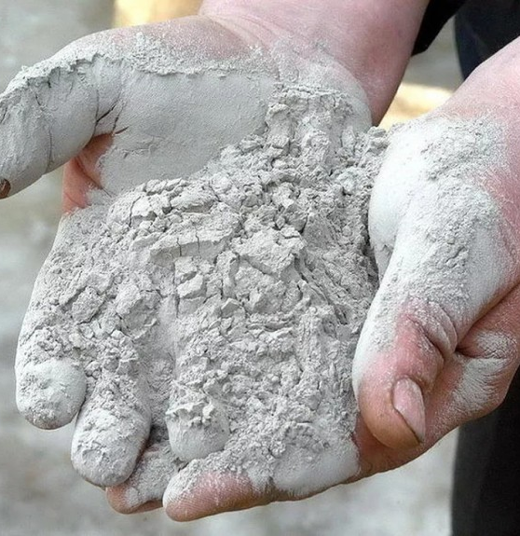
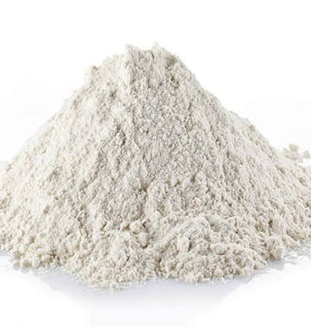
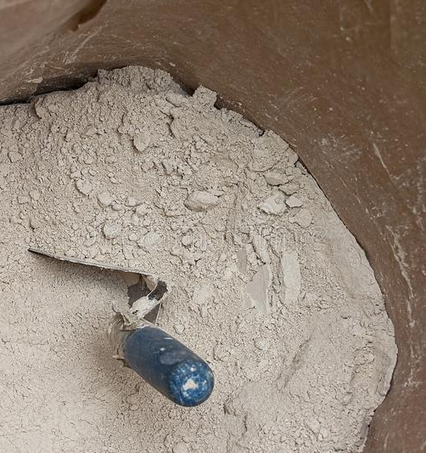
Production of gypsum binder
Production of high-quality gypsum binder based on new energy effective technologies to increase production efficiency and reduce production costs. The product is at high demand, driven by the construction boom in the country. It is also used for production of various products like drywalls. The production is based on local resource base
$2.1 mln.
$2.1 mln.
50’000 tons
Samarkand region, Kattakurgan city
IRR 19,2 %
NPV $1,5 mln
Local market
43 months
Available
Kattakurgan city administration
kattaqurgon@samarkand.uz
+99866 2319802

