Slide 1
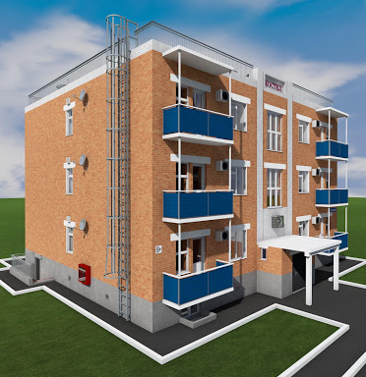
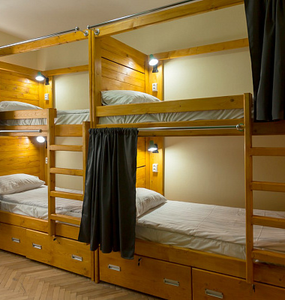
Hostel
Development of tourisms sector supported by new regulatory framework is favoring creation on a private sector hotel industry. In addition to traditional destinations, the goal is also to attract local tourists, including youngsters. This group is a main focus for hostels. Yet, the market cannot satisfy growing demand for beds, especially in high seasons.
$0,1 mln
$0,1 mln
100 places
Republic Of Karakalpakstan, Takhiatash district
IRR: 28,3%
NPV: $0,1 mln
36 months
Available
Takhiatash district administration
taxyatosh@karakalpakstan.uz
+99861 5721029

